Slide 1
CSC148 Ramp-up Winter 2017
Julianna Paprakis
Credit to: Michael Kimmins, Orion Buske, Velian Pandeliev, Jonathan Taylor, Noah Lockwood, and software-carpentry.org

Slide 2
Overview
In the next 6 hours, we’ll cover the background required for CSC148.
This session is for students with programming experience – We will not cover basic programming concepts, it will mostly be about Python-specific concepts.
Please ask questions!

Slide 3
Outline
Week 1 Administration Recap
Quick intro to basics
Blueprint of a Python file
Learn to speak Python
Lunch
Mutability & Aliasing
Debugging
Files - Reading & Writing
Unit Testing

Slide 4
Administration
We’re using the teaching lab environment to run your programs
Info for new students: http://www.teach.cs.toronto.edu/resources/intro_for_new_students.html
Python version 3.5 - PLEASE USE THIS!!!
https://www.python.org/downloads
Using the PyCharm IDE
You can use any IDE you prefer, but PyCharm does a lot of neat things for you ☺
More on this coming soon!

Slide 5

Intro & Basics

Slide 6
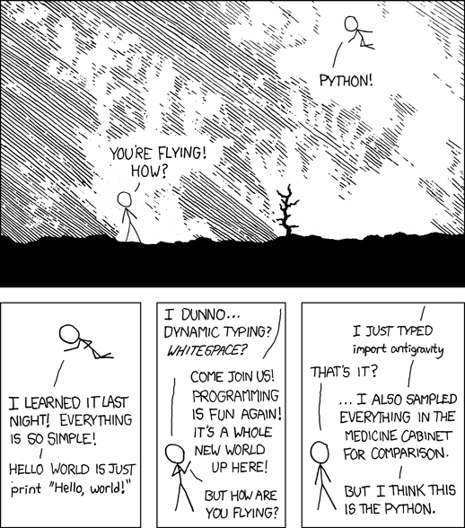

Slide 7
How to run Python
Programs are stored in .py files
Edit and run your program using an IDE (Integrated Dev. Environment) like PyCharm
You can also use the Python Console in PyCharm to run an interactive “shell”
Result is automatically shown (don’t need to “print” it like you would in a script)

Slide 8
Set up your environment
Open PyCharm IDE
Select “Open…”
Browse to and select your csc148 folder
Create a new “rampup” folder
In the project view, right click csc148 folder
New > Directory
Mark “rampup” folder as sources root
In the project view, right click rampup folder
Mark Directory as > Sources Root
Restart Console to Import Files
Open Console: View > Tool Windows > Python Console
Close Console: Press red ‘x’ on the side

Slide 9
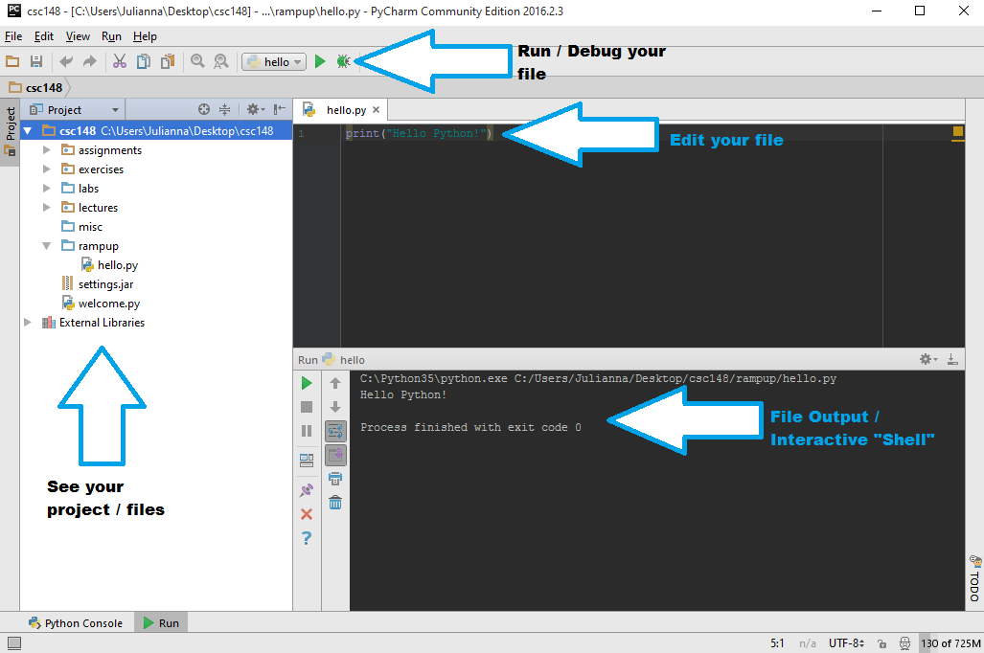
PyCharm IDE

Slide 10
Using Python Console
Import all the functions from a file
>>> from filename import function_name
-Don’t put the .py part of the filename
Press up key to view past commands

Slide 11
The blueprint of a Python file:
from random import randint
from math import cos
def my_function(arg):
...
return answer
class MyClass:
...
if __name__ == ‘__main__’:
my_variable = 21 * 2
...
import names from other modules
define functions and classes
your main block goes down here!

Slide 12
Modules (why reinvent the wheel?)
Python has a spectacular assortment of modules that you can use (you have to import their names first, though)
>>> from random import randint # now we can use it!
>>> randint(1, 6) # roll a die
4 # http://xkcd.com/221/
>>> import math
>>> math.sqrt(2) # note you have to say math.sqrt
1.4142135623730951
>>> from math import cos
>>> cos(0) # now we don’t have to use math.cos
1.0
>>> import datetime
>>> dir(datetime)

Slide 13
Demo Time!
Running vs. importing a file
Code in the main block only executes when running

Slide 14
Let's speak some Python
Interpreted (no compilation necessary)
Whitespace matters (4 spaces/1 tab for indentation)
No end-of-line character (no semicolons!)
No extra code needed to start (no "public static ...")
Dynamically typed (a function can take multiple different types, have different behaviors)
Strongly typed (all values have a type)
# Comments start with a '#' character.

Slide 15
Demo Time!
Interpreted (no compilation necessary)
Whitespace matters (4 spaces/1 tab for indentation)
No end-of-line character (no semicolons!)
No extra code needed to start (no "public static ...")
Dynamically typed (a function can take multiple different types, have different behaviors)
Strongly typed (all values have a type)
# Comments start with a '#' character.

Slide 16
Where to find Documentation
Official Python documentation:
http://docs.python.org/py3k/library/
The help function provides usage information:
>>> help(print)
The dir function shows names within a given type, module, object:
>>> dir(str)

Slide 17
Moar resources!
Last term's 108 and 148 course websites:
http://www.cdf.utoronto.ca/~csc108h/fall
http://www.cdf.utoronto.ca/~csc148h/fall
(Just google the fall courses)
Software Carpentry (online lectures):
http://software-carpentry.org/
Google!
http://lmgtfy.com/?q=python+add+to+list

Slide 18
Learn you to good speak Python
Python's style guide:
http://www.python.org/dev/peps/pep-0008/
Google's Python style guide:
http://google-styleguide.googlecode.com/svn/trunk/pyguide.html
Expert mode:
pylint: https://www.pylint.org

Slide 19
Python-Specific Syntax
Booleans: True False
Operators: and or not
Null: None
Strings: Immutable lists of characters
Can index into them
Can re-assign variables to a new string value
Type Conversions: str(5.33) = '5.33'

Slide 20
Sequences: [Lists]
Lists are a mutable sequence of any objects
>>> random_stuff = [42, 3.14, 'carpe diem']
>>> random_stuff[0] = 'Replaced!'
['Replaced!', 3.15, 'carpe diem']
Index and slice like strings:
>>> colours[0] # indexing returns the element
'cyan'
>>> random_stuff[2:] # slicing returns a sub-list
['carpe diem']

Slide 21
[Lists, of, things].stuff()
Lots of other awesome features, too
>>> marks = [74, 62, 54]
>>> len(marks) # size
3
>>> 54 in marks # membership testing
True
>>> marks.pop(1) # remove/return val at [1]
62
>>> marks + [1, 2] # concatenation
[74, 54, 1, 2] # new list

Slide 22
Sequences: (tuples)
Tuples are like fast, simple lists, that are immutable
>>> stuff = (42, 3.14, 'carpe diem')
>>> stuff[0] = 'a'
Traceback (most recent call last):
File "<stdin>", line 1, in <module>
TypeError: 'tuple' object does not support item assignment
Can always create a list from them:
>>> L = list(stuff)

Slide 23
{'dictionaries': 'awesome'}
Dictionaries (type dict) are an unordered association of keys with values
We usually use them to store associations:
like name -> phone number
phone number -> name
student id -> grade

Slide 24
{'dictionaries': 'awesome'}
Dictionaries (type dict) are an unordered association of keys with values
We usually use them to store associations:
like name -> phone number
phone number -> name
student id -> grade
grade -> student id #BAD, why?

Slide 25
{'dictionaries': 'awesome'}
Dictionaries (type dict) are an unordered association of keys with values
We usually use them to store associations:
like name -> phone number
phone number -> name
student id -> grade
grade -> list of student ids
Keys must be unique and immutable

Slide 26
{'dictionaries': 'awesome'}
>>> scores = {'Alice': 90, 'Bob': 76, 'Eve': 82}
>>> scores['Alice'] # get
90
>>> scores['Charlie'] = 64 # set
>>> scores.pop('Bob') # delete
76
>>> 'Eve' in scores # membership testing
True
>>> for name in scores: # loops over keys
... print("{}: {}".format(name, scores[name]))
...
Charlie: 64
Alice: 88
Eve: 82

Slide 27
For loops!
For loops repeat some code for each element in a sequence
This is a foreach loop in most languages
>>> colours = ['red', 'green', 'blue']
>>> for colour in colours:
... print(colour)
...
red
green
blue

Slide 28
For loops!
But wait, I actually wanted the index!
Use range(n) in a for loop to loop over a range.
>>> for i in range(2):
... print(i)
0
1
To start at a value other than 0:
>>> for i in range(4, 6):
... print(i)
4
5

Slide 29
For loops!
zip returns a list of pairs
>>> colours = ['red', 'green', 'blue']
>>> n = len(colours)
>>> for i, colour in zip(range(n), colours):
... print(‘{}. {}’.format(i, colour))
...
0. red
1. green
2. blue

Slide 30
For loops!
enumerate assigns a number to each element
>>> for i, colour in enumerate(colours):
... print("{}. {}".format(i, colour))
...
0. red
1. green
2. blue

Slide 31
While loops
While loops keep repeating a block of code while a condition is True
# What does this code do?
val = 10
while val > 0:
print(‘hello’)
val -= 1
# prints ‘hello’ 10 times

Slide 32
While loops
break can be used to exit a loop early
# What does this code do?
while True: # This is an infinite loop
# Stop when the user types 'quit', 'Q', etc.
response = input("Enter number or 'quit':")
if response.lower().startswith('q'):
break # This breaks out of the loop
...

Slide 33
Conditionals (if, elif, else)
If statements allow you to execute code sometimes (based upon some condition)
elif (meaning 'else if') and else are optional
if amount > balance:
print(‘You have been charged a $20’
‘ overdraft fee. Enjoy.’)
balance -= 20
elif amount == balance:
print(‘You're now broke’)
else:
print(‘Your account has been charged’)
balance -= amount # deduct amount from account

Slide 34
Exercise 1.1: Dictionaries – Simple Formatting
Complete 1.1 – Dictionaries Simple Formatting on the exercise sheet

Slide 35
Exercise 1.1: Solution
for pin in record:
print('{} (#{})'.format(record[pin], pin))

Slide 36
Exercise 1.2: Dictionaries – Loops and Dictionaries
Complete 1.2 – Loops and Dictionaries on the exercise sheet

Slide 37
Exercise 1.2: Solution
counts = {}
for line in file:
for word in line.split():
if word in counts:
counts[word] += 1
else:
counts[word] = 1

Slide 38
Functions
Allow you to group together a bunch of statements into a block that you can call.
Important: If you don't specify a return value, it will be None
def celsius_to_fahrenheit(degrees):
return (9 / 5) * degrees + 32
f = celsius_to_fahrenheit(100)

Slide 39
Functions – Design Recipe
1. Example Calls: doctests – will cover this more later
>>> celsius_to_fahrenheit(10)
50
Type Contract: The argument(s) and return type(s)
@type degrees: (int or float)
@rtype: float
3. Header
def celsius_to_fahrenheit(degrees):
Note: There are multiple ways to write the type contract. Use what you are shown in class if it is different from these slides.

Slide 40
Functions – Design Recipe (cont.)
4. Description: what the function does, not how it does it
Convert degrees from C to F.
5. Body: The actual function code
return (9 / 5) * degrees + 32
6. Test Your Function – More on this later ☺

Slide 41
Functions – Design Recipe (cont.)
The part of the function in triple-quotes is the docstring
It is shown when help is called on your function
Putting it all together we get:
def celsius_to_fahrenheit(degrees):
""" Convert degrees from C to F.
@type degrees: (int or float)
@rtype: float
>>> celsius_to_fahrenheit(10)
50
"""
return (9 / 5) * degrees + 32

Slide 42
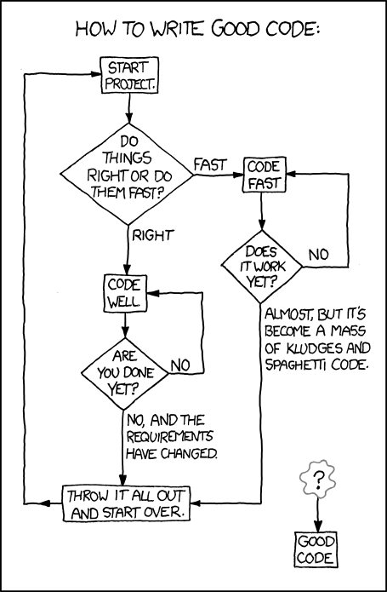

Slide 43
More Function control tools
Pass: A null operation. Nothing happens
>>> def skip_5_until_10 (number):
... for index in range(number):
... if number == 10:
... break
... elif number == 5:
... pass
... else:
... print(number)
... return None

Slide 44
Functions Changing things
Functions can modify mutable arguments
Let’s say we want a function to take a list, and return a list that is double the initial list: Does this function work?
def double(L):
""" Modify L so it is equivalent to L + L.
@type L: list
@rtype: None
"""
for i in range(len(L)):
L.append(L[i])
>>> L = [1, 2, 3]
>>> L = double(L) # Don't do this! Why?
# double(L) changes the list and then returns None
>>> print(L) # We expect [1, 2, 3, 1, 2, 3]

Slide 45
How would you fix this function?
We want the original list L to be doubled
We don’t want the original list L to end up as None
Don’t actually need to change the function, just how we call it!
def double(L):
""" Modify L so it is equivalent to L + L.
@type L: list
@rtype: None
"""
for i in range(len(L)):
L.append(L[i])
>>> L = [1, 2, 3]
>>> double(L) # Call double L without assigning L to its return value
# double(L) changes the list and then returns None
>>> print(L) # We get [1, 2, 3, 1, 2, 3]

Slide 46
Exercise 2.1: Functions– Simple Function Reuse
Complete 2.1 –Simple Function Reuse on the exercise sheet

Slide 47
Exercise 2.1: Solution
def to_listing(first_name, last_name, phone_number):
""" Returns a string in the format last_name, first_name: phone_number)
@type first_name: str
@type last_name: str
@type phone_number: str
@rtype: str
"""
return format_name(first_name, last_name) + ': ' + phone_number

Slide 48
Eat ALL the things…

Slide 49
Memory & Mutability
It is important to understand how memory works to know how your code will behave
We know strings are immutable, and lists are mutable, but what implications does that have?
If you assign a variable to an immutable object (like a string), and then change where the variable refers to, a whole new object is created in memory, and the variable points to that new object
If you assign a variable to a mutable object (like a list), and then change the value that the variable refers to, the variable will continue to point to the the original object, which has been internally changed

Slide 50
Memory Model
You can model how your program’s memory will look
Use the Python visualizer at http://www.pythontutor.com/visualize.html
Set language to Python 3.3
Set “render all objects on the heap”

Slide 51
Variable aliasing - Mutable
Careful! Multiple variables might be referring to the same mutable data structure
>>> sorted_list = [1, 2, 3]
>>> not_a_copy = sorted_list # not a copy
>>> not_a_copy.append(0)
>>> sorted_list
[1, 2, 3, 0] # crap
>>> actually_a_copy = list(sorted_list)
>>> another_copy = sorted_list[:]

Slide 52
Variable aliasing - Mutable
What if we try to assign not_a_copy to a whole new list? Will sorted_list change?
>>> sorted_list = [1, 2, 3]
>>> not_a_copy = sorted_list # not a copy
>>> not_a_copy = [4, 5, 6]
>>> sorted_list
[1, 2, 3] # nope we’re still OK!
We assigned not_a_copy to an entirely new list, which changed which object it was referring to
sorted_list will still refer to the original list

Slide 53
Back to the double function above
We were able to change the value of L in the function
Lets run the memory simulator on this function to see why L changes
def double(L):
""" Modify L so that it is equivalent to L + L
@type L: list
@rtype: list
"""
for i in range(len(L)):
L.append(L[i])
L = [1, 2, 3]
L = double(L) # Don't do this! Why?
# double(L) changes the list and then returns None
print(L) # We expect[1, 2, 3, 1, 2, 3]

Slide 54
How would you fix this function?
We don’t want the original list to change
We want double(L) to return something
def double(L):
""" Modify L so that it is equivalent to L + L
@type L: list
@rtype: list
"""
for i in range(len(L)):
L.append(L[i])
L = [1, 2, 3]
L = double(L) # Don't do this! Why?
# double(L) changes the list and then returns None
print(L) # [1, 2, 3, 1, 2, 3]

Slide 55
Solution
def double(L):
""" Create a new list that is equivalent to L + L
@type L: list
@rtype: list
"""
newList = []
for j in range(2):
for i in range(len(L)):
newList.append(L[i])
return newList
L = [1, 2, 3]
endList = double(L)
print (endList) # [1, 2, 3, 1, 2, 3]
print(L) # [1, 2, 3]

Slide 56
Exercise 3.1: Memory & Mutability – Variable Assignment
Complete 3.1 – Variable Assignment on the exercise sheet

Slide 57
Exercise 3.1: Solution
a: [0, 1, 10, 3, 4]
b: [0, 1, 10, 3, 4]
c: 20
d: [0, 1, 10, 3, 4]
Let’s visualize this!!

Slide 58
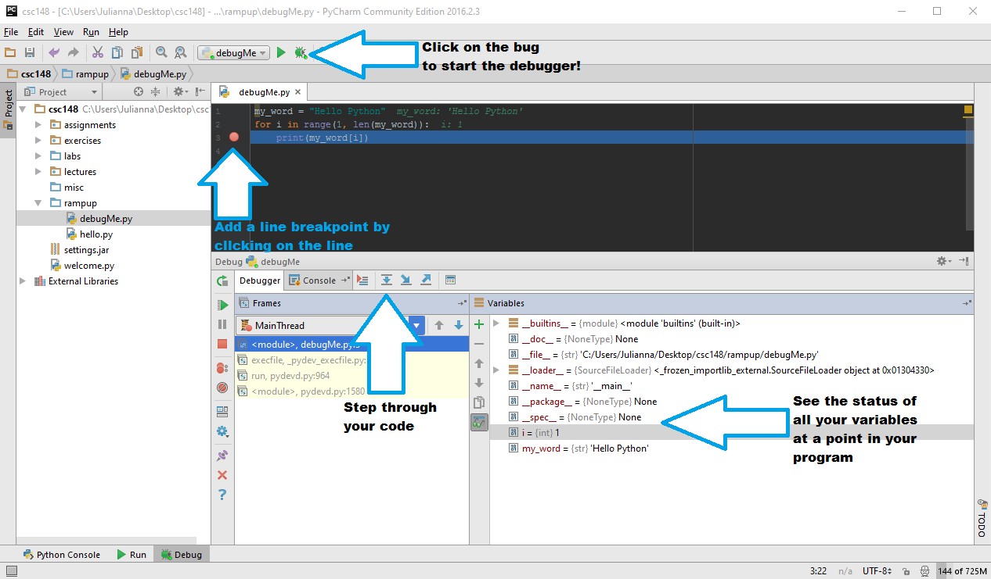
The Debugger

Slide 59
Standard input/output
Generating output (stdout): print()
Can take multiple arguments (will be joined with spaces)
print() doesn’t return a value
Reading keyboard input: input()
>>> name = input() >>> name 'Orion'
>>> print(‘Hello ’ + name)
Hello Orion
>>> ‘Hello {}’.format(name)
'Hello Orion' # Why quotes here?
>>> printed_name = print(‘Hello ’ + name)
>>> printed_name

Slide 60
A brief detour to open some files
Use with/as to open something for a while, but always close it, even if something goes wrong.
Reading Files:
with open('myfile.txt') as open_file:
for line in open_file:
... # do something with each line

Slide 61
A brief detour to open some files
Writing Files:
balance = 40
with open(‘output.txt’, ‘w’) as file:
file.write(‘I can write\n’)
file.write(‘Account balance{}\n’.format(balance))

Slide 62
A brief detour to open some files
Given this list:
>>> characters = [‘Frodo Baggins’, ‘Samwise Gamgee’, ‘Gandalf’, ‘Aragorn II’, ‘Legolas Greenleaf’, ‘Meriadoc Brandybuck’, ‘Peregrin Took’]
Write code that takes the list, and writes its contents (one on each line) to the file tolkien.txt.
Syntax to remember:
with open(‘filename.txt’, ‘w’) as my_file:
#do stuff here
my_file.write(‘my variable here:{}\n’.format(myvar))

Slide 63
A brief detour to open some files
Given this list:
>>> characters = [‘Frodo Baggins’, ‘Samwise Gamgee’, ‘Gandalf’, ‘Aragorn II’, ‘Legolas Greenleaf’, ‘Meriadoc Brandybuck’, ‘Peregrin Took’]
Write code that takes the list, and writes its contents (one on each line) to the file tolkien.txt.
>>> with open(‘tolkien.txt’, ‘w’) as file:
... for name in characters:
... file.write(‘{}\n’.format(name))
... file.close()

Slide 64
A brief detour to open some files
Use the text file we made right now, read from the file tolkien.txt and store each line in a list characters.

Slide 65
A brief detour to open some files
Use the text file we made right now, read from a file tolkien.txt and store each line in a list characters.
>>> with open(‘tolkien.txt’) as file:
... characters = file.readlines()
...
>>> characters
['Frodo Baggins\n', 'Samwise Gamgee\n', 'Gandalf\n', 'Aragorn II\n', 'Legolas Greenleaf\n', 'Meriadoc Brandybuck\n', 'Peregrin Took\n']
What happened?

Slide 66
A brief detour to open some files
Use the text file we made right now, read from a file tolkien.txt and store each line in a list characters.
>>> characters = []
>>> with open(‘tolkien.txt’) as file:
... for line in file:
... characters.append(line.strip())
>>> characters
['Frodo Baggins', 'Samwise Gamgee', 'Gandalf', 'Aragorn II', 'Legolas Greenleaf', 'Meriadoc Brandybuck', 'Peregrin Took']
Better.

Slide 67

Testing the code

Slide 68
Testing the code
Why test?
Assures correctness of the program under specific conditions
Thinking of testing while coding makes the coder write code that is better designed
Helps you think about edge cases (e.g. What if user tries to delete a file that isn’t there? What if a function that takes mutable data is given an immutable type?)

Slide 69
Doctest vs. Unit test
Doctest
Informs others on how to expect your function to be used / the edge cases they may encounter
Unit test
Able to run tests in a separate file which allows you to run more without worrying about cluttering the docstring
Use both!!

Slide 70
Lets test this code
even.py
def is_even(num):
""" return True if num is even.
@type num: int
@rtype: bool
"""
return num % 2 == 0

Slide 71
Lets test this code - Doctests
def is_even(num):
""" return True if num is even.
@type num: int
@rtype: bool
>>> is_even(2)
True
>>> is_even(3)
False
"""
return num % 2 == 0
if __name__ == ‘__main__’:
import doctest
doctest.testmod()

Slide 72
Lets test this code – Unit Tests
import unittest
from even import is_even
class EvenTestCase(unittest.TestCase):
def test_is_two_even(self):
self.assertTrue(is_even(2))
class OddTestCase(unittest.TestCase):
def test_is_three_odd(self):
self.assertFalse(is_even(3))
if __name__ == '__main__':
unittest.main()

Slide 73
Lets test this code
In unit testing, test_* methods are recognized by the module.

Slide 74
Exercise 4.1: Testing the Code – Unit Tests
Complete 4.1 – Unit Tests on the exercise sheet

Slide 75
Exercise 4.1: Solution
def test_most_employees_one_item(self):
companies = {‘Walmart’:[‘Bob’, ‘Jane’]}
actual = employees.most_employees(companies)
expected = [‘Walmart’]
self.assertEqual(actual, expected)
def test_most_employees_mutation(self):
actual = {‘Walmart’:[‘Bob’, ‘Jane’]}
employees.most_employees(actual)
expected = {‘Walmart’:[‘Bob’, ‘Jane’]}
self.assertEqual(actual, expected)

Slide 76
Exercise 4.2: Testing the Code – Doctests
Complete 4.2 – Doctests on the exercise sheet

Slide 77
Exercise 4.2: Solution
Two companies tie:
>>> most_employees({'Walmart':['Trish', 'Bob'], 'Subway':['Joe', 'Anne']}
[‘Walmart’, ‘Subway’]
One company:
>>> most_employees({'Walmart':['Trish', 'Bob']}
[‘Walmart’]
Any others you thought of?
Note: this doesn’t necessarily work, because we cannot assume the order of a dictionary: the function may give us the companies in a list in reverse order [‘Subway’, ‘Walmart’] which is still valid. Can you think of a way to handle this doctest?

Slide 78

Getting Help
There is lots of help available
Bogdan’s office hours: M 11:30-1, BA4268
Danny’s office hours: M 2:30-3, W 11:30-1, BA4270
Piazza
during lab, from your TA
Help Centre, first-year: Mon-Thu, 1-3pm, Fri 1-4pm, BA2230
You can go to “regular” help centre hours too!
Don’t spin your wheels. Come talk to us!

