Slide 1
CSC148 Ramp-up
Fall 2014
Michael Kimmins
(Based mostly on slides from Orion Buske)
(based on notes by Velian Pandeliev, Jonathan Taylor, Noah Lockwood, and software-carpentry.org)

Slide 2
Overview
In the next 6 hours, we’ll cover the background required for CSC148.
This session is for students with programming experience who haven't necessarily taken the prerequisite, CSC108.
Please ask questions!

Slide 3
Outline
Talking
Talking
Talking
Lunch
Talking
Talking
Talking

Slide 4
More explicit outline
Variables and types
Lists, tuples, and for loops
Conditionals and functions
Lunch
Dictionaries and files
While loops and modules
Classes and objects

Slide 5

Meet Python...

Slide 6
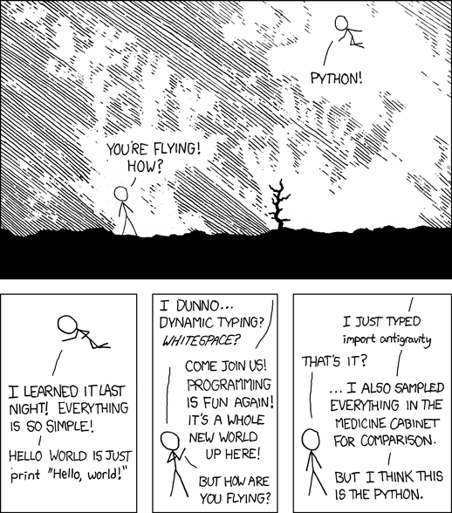

Slide 7
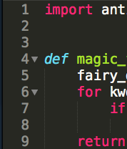
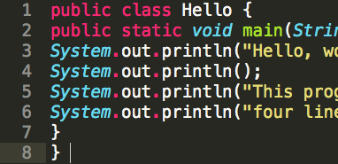
Whitespace matters
vs

Slide 8
Let's speak some Python
Python is interpreted (no compilation necessary)
Whitespace matters (4 spaces for indentation)
No end-of-line character (no semicolons!)
No extra code needed to start (no "public static ...")
Python is dynamically typed (a function can take multiple different types, have different behaviors)
Python is strongly typed (all values have a type)
# Comments start with a '#' character.
# Python has dynamic typing, so:
x = 5 # assignment statement (no type specified)
x = "jabberwocky" # re-assign x to a string
print(x) # prints "jabberwocky"

Slide 9
Let's speak some Python
Python is strongly typed.
>>> def foo(x):
... return x+1
...
>>> foo(1)
2
>>> foo("a")
Traceback (most recent call last):
File "<stdin>", line 1, in <module>
File "<stdin>", line 2, in foo
TypeError: cannot concatenate 'str' and 'int' objects

Slide 10
Let's speak some Python
Python is dynamically typed.
>>> def foo(x):
... y = x + 1
... z = y + "a"
... return z
...
>>> foo (1)
Traceback (most recent call last):
File "<stdin>", line 1, in <module>
File "<stdin>", line 3, in foo
TypeError: unsupported operand type(s) for +: 'int' and 'str'

Slide 11
Let's speak some Python
Programmer must provide type safety
>>> def bar(x):
... if type(x) == int:
... print "This is an int."
... else:
... print "This is something else."
...
>>> bar(4)
This is an int.
>>>
>>> bar("4")
This is something else.

Slide 12
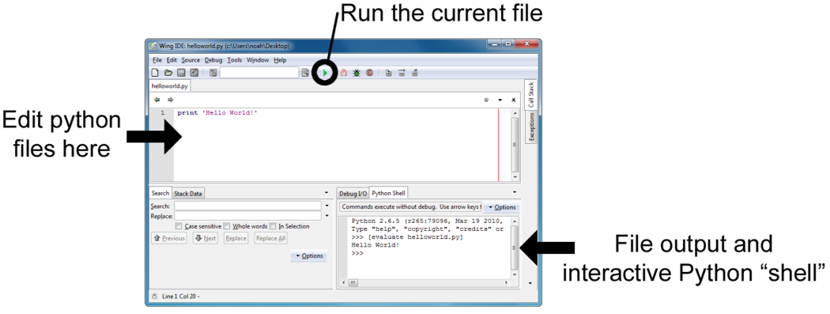
Python programs
Programs are stored in .py files
From the command line (for teh hax0rz):
Using the Wing IDE (Integrated Dev. Environment)
#user@redwolf:~$ python myfile.py

Slide 13
The blueprint of a Python file:
from random import randint
from math import cos
import names from other modules

Slide 14
The blueprint of a Python file:
from random import randint
from math import cos
def my_function(arg):
...
return answer
class MyClass:
...
import names from other modules
define functions and classes

Slide 15
The blueprint of a Python file:
from random import randint
from math import cos
def my_function(arg):
...
return answer
class MyClass:
...
if __name__ == "__main__":
my_variable = 21 * 2
...
import names from other modules
define functions and classes
your main block goes down here!

Slide 16
The blueprint of a Python file:
from random import randint
from math import cos
def my_function(arg):
...
return answer
class MyClass:
...
if __name__ == "__main__":
my_variable = 21 * 2
...
the main block mantra

Slide 17
The blueprint of a Python file:
from random import randint
from math import cos
def my_function(arg):
...
return answer
class MyClass:
...
if __name__ == "__main__":
my_variable = 21 * 2
...
note the case of different names and how we use whitespace

Slide 18
Interactive Python
Python can also be run interactively, from the bottom-right of Wing, or by typing python or python3 on the command line.
The result is automatically shown (unlike in a program, where you must call print).
#user@redwolf:~$ python
Python 3.2.3 (v3.2.3:3d0686d90f55, Apr 10 2012, 11:25:50)
Type "help", "copyright", "credits" or "license" for more information.
>>> 42
42
>>> (2 ** 3 - 4) / 8
0.5

Slide 19
Getting help
Official Python documentation:
http://docs.python.org/py3k/library/
The help function provides usage information:
>>> help(print)
The dir function shows names within a given type, module, object:
>>> dir(str)

Slide 20
Moar resources!
Last term's 108 and 148 course websites:
http://www.cdf.utoronto.ca/~csc108h/summer/
http://www.cdf.utoronto.ca/~csc148h/summer/
Software Carpentry (online lectures):
http://software-carpentry.org/
Google!
http://lmgtfy.com/?q=python+add+to+list

Slide 21
Learn you to good speak Python
Python's style guide:
http://www.python.org/dev/peps/pep-0008/
Google's Python style guide:
http://google-styleguide.googlecode.com/svn/trunk/pyguide.html
Expert mode:
pychecker: http://pychecker.sourceforge.net/
pyflakes: https://launchpad.net/pyflakes/

Slide 22
Variables (storing data)
Variables refer to an object of some type
Several basic data types:
Integers (whole numbers): int
  >>> the_answer = 42
Floating-point (decimal) numbers: float
  >>> pi = 3.14159
  >>> radius = 2.0
  >>> pi * (radius ** 2)
  12.56636
operators: * / % + - ** //
"shortcut" operators: x = x + 1 → x += 1

Slide 23
More types (kinds of things)
Boolean (True/False) values: bool
  >>> passed = False
  >>> not passed
  True
  >>> 5 < 4 # comparisons return bool
  False
  >>> 5 and 4 # this can bite you
  4
Operators: and or not

Slide 24
More types (kinds of things)
None (it's Python's NULL): NoneType
  >>> x = None
  >>> print(x)
  None
  >>> x
  >>> type(x)
  <type 'NoneType'>
  >>> # Weird, we'll discuss this later

Slide 25
Strings
Strings (basically lists of characters): str
  >>> welcome = "Hello, world!"
  >>> welcome[1] # index, starting with 0
  'e'
Slices return substrings:
  >>> welcome[1:5] # slice with [start:end]
  'ello'
  >>> welcome[:3] # start defaults to 0
  'Hel'
  >>> welcome[9:] # end defaults to None (wtf?)
  'rld!'
  >>> welcome[:-1] # index/slice with negatives
  'Hello, world'

Slide 26
Working with strings
Stick strings together (concatenation):
  >>> salutation = "Hello, "
  >>> name = "Orion"
  >>> salutation + name # evaluates to a new string
  'Hello, Orion'
The len function is useful:
  >>> len(name) # number of characters
  5

Slide 27
Tons of useful methods
Here are some, look at help(str) for more:
  >>> name = "Orion"
  >>> name.endswith('ion')
  True
  >>> 'rio' in name # substring testing
  True
  >>> name.startswith('orio')
  ???? Thoughts?
  >>> name.lower()
  'orion' # new string!
  >>> name.index('i')
  2 # What did this do? Try help(str.index)

Slide 28
POP QUIZ!
Write a boolean expression that evaluates to:
True if the variable response starts with the letter "q", case-insensitive, or
False if it does not.
(in CS lingo, we'd say: True iff (if and only if) the variable response starts with the letter "q", case-insensitive)

Slide 29
POP QUIZ!
response.lower().startswith('q')

Slide 30
A little more on strings
Strings are immutable, meaning they can't be changed once created
  >>> name = 'Orion'
  >>> name[1] = 'n'
  Traceback (most recent call last):
  File "<stdin>", line 1, in <module>
  TypeError: 'str' object does not support item assignment
Empty strings are OK:
>>> what_i_have_to_say = ''

Slide 31
Making strings pretty
String formatting (str.format):
  http://docs.python.org/release/3.1.5/library/string.html#formatstrings
  {} are replaced by the arguments to format
  Formatting parameters can be specified using :format
    Similar to printf
>>> n = 99
>>> where = "on the wall"
>>> '{} bottles of beer {}'.format(n, where)
'99 bottles of beer on the wall'

Slide 32
Standard input/output
Generating output (stdout): print()
  Can take multiple arguments (will be joined with spaces)
Reading keyboard input: input()
>>> name = input()
>>> name
'Orion'
>>> print("Hello " + name)
Hello Orion
>>> "Hello {}".format(name)
'Hello Orion' # Why quotes here?

Slide 33
Converting between types
AKA: how to sanitize user input
Functions: int(), float(), str(), bool()
>>> float('3.14')
3.14
>>> int(9 / 5) # truncates
1
>>> float(3)
3.0
>>> str(3.14)
'3.14'
>>> '{:.4f}'.format(3.14159265358)
'3.1416'

Slide 34
Converting between types
Don't do anything silly:
>>> int('fish')
Traceback (most recent call last):
File "<stdin>", line 1, in <module>
ValueError: invalid literal for int() with base 10: 'fish'
And beware:
>>> int('3.0')
Traceback (most recent call last):
File "<stdin>", line 1, in <module>
ValueError: invalid literal for int() with base 10: '3.0'

Slide 35
Exercise 1: Temperature
C = (5 / 9) * (F - 32)
Write a program that:
  prompts the user for degrees in Fahrenheit
  converts the number into Celsius
  prints out the number in Celsius
    to just 2 decimal places, if you dare
  (You can assume the user enters a number)

Slide 36
Exercise 1: Solution
Self-check: does your code work for 98.6?
# Read in the input
fahrenheit = float(input("Input temperature (F): ”))
# Convert to Celsius
celsius = (5 / 9) * (fahrenheit - 32)
# Display the answer
print("Temperature is {:.2f} degrees C".format(celsius))

Slide 37
Sequences, of, things!
There are two main kinds of sequences (things in an order) in Python:
- The [mighty] list
- The (humble,) tuple

Slide 38
[Lists, of, things]
Lists are a very important data structure in Python
They are a mutable sequence of any objects
>>> colours = ['cyan', 'magenta', 'yellow']
>>> friends = [] # forever alone
>>> random_stuff = [42, 3.14, 'carpe diem']
>>> wtf = [[], [2, 3], friends] # this is crazy
>>> my_friends = list(friends) # copy a list
Index and slice like strings:
>>> colours[0] # indexing returns the element
'cyan'
>>> random_stuff[2:] # slicing returns a sub-list
['carpe diem']

Slide 39
[Lists, of, things].stuff()
We can change, add, and remove elements from lists
>>> marks = [98, None, 62, 54]
>>> marks[1] = 75 # change that None
>>> marks.append(90) # add 90 to the end
>>> marks.remove(62) # remove the 62
>>> marks.sort() # sort in place
>>> print(marks)
??? Thoughts?
[54, 75, 90, 98]

Slide 40
[Lists, of, things].stuff()
Lots of other awesome features, too
>>> marks = [74, 62, 54]
>>> len(marks) # size
3
>>> 54 in marks # membership testing
True
>>> marks.pop(1) # remove/return val at [2]
62
>>> marks + [1, 2] # concatenation
[74, 54, 1, 2] # new list

Slide 41
Variable aliasing
Careful! Multiple variables might be referring to the same mutable data structure:
>>> sorted_list = [1, 2, 3]
>>> not_a_copy = sorted_list # not a copy
>>> not_a_copy.append(0)
>>> sorted_list
[1, 2, 3, 0] # crap
>>> actually_a_copy = list(sorted_list)
>>> another_copy = sorted_list[:]

Slide 42
(Tuples, of, things)
Tuples are like fast, simple lists, that are immutable
>>> stuff = (42, 3.14, 'carpe diem')
>>> stuff[0] = 'a'
Traceback (most recent call last):
File "<stdin>", line 1, in <module>
TypeError: 'tuple' object does not support item assignment
Can always create a list from them:
>>> L = list(stuff)
>.< A little weird to get a 1-element tuple:
('a') -> 'a'
('a',) -> ('a',)

Slide 43
For loops! (you spin me right round baby...)
For loops repeat some code for each element in a sequence
  This is a foreach loop in most languages
>>> colours = ['red', 'green', 'blue']
>>> for colour in colours:
... print(colour)
...
red
green
blue

Slide 44
For loops! (you spin me right round baby...)
But wait, I actually wanted the index!
  Use range(n) in a for loop to loop over a range.
>>> for i in range(2):
... print(i)
0
1
  To start at a value other than 0:
>>> for i in range(4, 6):
... print(i)
4
5

Slide 45
For loops! (you spin me right round baby...)
But wait, I actually wanted the index!
  How should we loop over the indices of a list?
>>> for i in range(len(colours)):
... print("{}. {}".format(i, colours[i]))
...
0. red
1. green
2. blue

Slide 46
For loops! (you spin me right round baby...)
But wait, I actually wanted the index!
  Now, over the indices and items!
>>> n = len(colours)
>>> for (i, colour) in zip(range(n), colours):
... print("{}. {}".format(i, colour))
...
0. red
1. green
2. blue
zip returns a list of pairs

Slide 47
For loops! (you spin me right round baby...)
But wait, I actually wanted the index!
  Now, over the indices and items!
>>> for (i, colour) in enumerate(colours):
... print("{}. {}".format(i, colour))
...
0. red
1. green
2. blue

Slide 48
Exercise 2: Times table
Compute (and store in a variable) a times table for the numbers 0 through 9 as a list of lists.
For example, if it were just from 0 through 2, you should create:
[[0, 0, 0],
[0, 1, 2],
[0, 2, 4]]

Slide 49
Exercise 2: Solution
table = []
n = 10 # from 0 to (n - 1)
for i in range(n):
# Compute the n'th row
row = []
for j in range(n):
row.append(i * j)
# Add row to full table
table.append(row)

Slide 50
Exercise 2: Solution
table = []
n = 10 # from 0 to (n - 1)
for i in range(n):
# Compute the n'th row
row = []
# Add row to full table
table.append(row)
for j in range(n):
row.append(i * j)
Does this still work?

Slide 51
Exercise 2: Alternate solution
table = [[row * col for col in range(10)]
for row in range(10)]
(list comprehensions FTW!)

Slide 52
Conditionals (if, elif, else)
If statements allow you to execute code sometimes (based upon some condition)
elif (meaning 'else if') and else are optional
if amount > balance:
print("You have been charged a $20"
" overdraft fee. Enjoy.")
balance -= 20
elif amount == balance:
print("You're now broke")
else:
print("Your account has been charged")
balance -= amount # deduct amount from account

Slide 53
Functions (basically the best things ever)
They allow you to group together a bunch of statements into a block that you can call.
"If you have the same code in two places, it will be wrong in one before long."
"Never copy-paste code if at all possible."
They can take in information (arguments) and give back information (return value).
Important: If you don't specify a return value, it will be None
def celsius_to_fahrenheit(degrees):
return (9 / 5) * degrees + 32
f = celsius_to_fahrenheit(100)

Slide 54
Docstrings
They should have a docstring (a multi-line, meaning triple-quoted, string right after the declaration)
Describes what the function does, not how it does it.
Describe the argument and return types.
It is shown when help is called on your function, so it should be sufficient for other people to know how to use your function.
def celsius_to_fahrenheit(degrees):
"""(int or float) -> float
Convert degrees from C to F.
"""
return (9 / 5) * degrees + 32

Slide 55
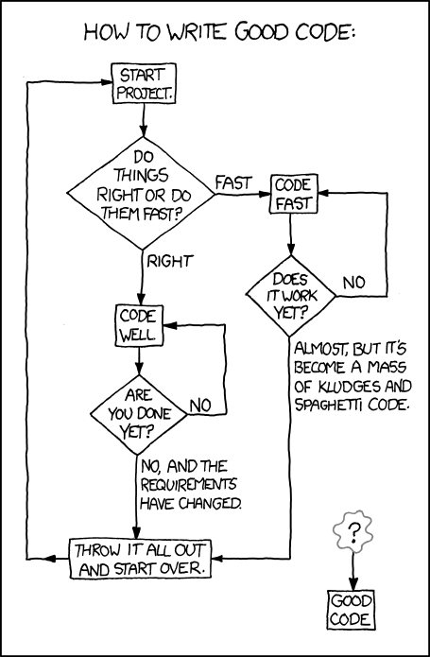
Very important.

Slide 56
Changing things
Functions can modify mutable arguments
def double(L):
"""list -> NoneType
Modify L so it is equivalent to L + L
"""
for i in range(len(L)):
L.append(L[i])
L = [1, 2, 3]
L = double(L) # Don't do this! Why?
# double(L) changes the list and then returns None

Slide 57
Changing things
Functions can modify mutable arguments
If no return is specified, None is returned
def double(L):
"""list -> NoneType
Modify L so it is equivalent to L + L
"""
for i in range(len(L)):
L.append(L[i])
L = [1, 2, 3]
double(L)
print(L) # [1, 2, 3, 1, 2, 3]

Slide 58
Changing things
Immutable:
>>> stuff = (42, 3.14, 'carpe diem')
>>> stuff[0] = 'a'
Traceback (most recent call last):
File "<stdin>", line 1, in <module>
TypeError: 'tuple' object does not support item assignment

Slide 59
Changing things
Immutable:
>>> hi = "hello"
>>> hi[0]
'h'
>>> hi[0] = "j"
Traceback (most recent call last):
File "<stdin>", line 1, in <module>
TypeError: 'str' object does not support item assignment

Slide 60
Changing things
Immutable:
>>> a[0]
1
>>> a[0] = 2
Traceback (most recent call last):
File "<stdin>", line 1, in <module>
TypeError: 'tuple' object does not support item assignment

Slide 61
Changing things
mutable:
>>> list = [1,2,3,4]
>>> list[0]
1
>>> list[0] = 10
>>> list
[10, 2, 3, 4]

Slide 62
More control tools
Break: “break out” of the loop. Think of breaking from a prison
Pass: A null operation. Nothing happens
>>> def do_something(number):
... for index in range(number):
... if number == 2:
... break
... if number == 3:
... pass
... else:
... print(number)
... return None

Slide 63
Exercise 3: Functions
Two words are a reverse pair if each word is the reverse of the other.
1) Write a function is_reverse_pair(s1, s2) that returns True iff s1 and s2 are a reverse pair.
2) Write a function print_reverse_pairs(wordlist) that accepts a list of strings and prints out all of the reverse pairs in the given list, each pair on a line.

Slide 64
Exercise 3: Solution
def is_reverse_pair(s1, s2):
"""(str, str) -> bool"""
pass

Slide 65
Exercise 3: Solution
def is_reverse_pair(s1, s2):
if len(s1) != len(s2):
return False
for i in range(len(s1)):
if s1[i] != s2[len(s2) - 1 – i]:
return False
return True
Or, using slicing:
def is_reverse_pair(s1, s2):
return s1[::-1] == s2

Slide 66
Exercise 3: Solution
def print_reverse_pairs(wordlist):
"""list -> NoneType"""
pass

Slide 67
Exercise 3: Solution
def print_reverse_pairs(wordlist):
for s1 in wordlist:
for s2 in wordlist:
if is_reverse_pair(s1, s2):
print("{}, {}".format(s1, s2))

Slide 68
Eat ALL the things…

Slide 69
{'dictionaries': 'awesome'}
Dictionaries (type dict) are an unordered association of keys with values
We usually use them to store associations:
  like name -> phone number
  phone number -> name
  student id -> grade

Slide 70
{'dictionaries': 'awesome'}
Dictionaries (type dict) are an unordered association of keys with values
We usually use them to store associations:
  like name -> phone number
  phone number -> name
  student id -> grade
  grade -> student id #BAD, why?

Slide 71
{'dictionaries': 'awesome'}
Dictionaries (type dict) are an unordered association of keys with values
We usually use them to store associations:
  like name -> phone number
  phone number -> name
  student id -> grade
  grade -> list of student ids
Keys must be unique and immutable

Slide 72
{'dictionaries': 'awesome'}
>>> scores = {'Alice': 90, 'Bob': 76, 'Eve': 82}
>>> scores['Alice'] # get
90
>>> scores['Charlie'] = 64 # set
>>> scores.pop('Bob') # delete
76
>>> 'Eve' in scores # membership testing
True
>>> for name in scores: # loops over keys
... print("{}: {}".format(name, scores[name]))
...
Charlie: 64
Alice: 88
Eve: 82

Slide 73
A brief detour to open some files
The naïve way:
f = open("myfile.txt")
for line in f:
... # do something with each line
f.close()
# What happens if an error occurs?

Slide 74
A brief detour to open some files
Use with/as to open something for a while, but always close it, even if something goes wrong.
Easiest way to read files:
with open('myfile.txt') as open_file:
for line in open_file:
... # do something with each line
Easiest way to write to files:
with open('myfile.txt', 'w') as open_file:
print(data, file=open_file) # write to the file

Slide 75
A brief detour to open some files
Writing
balance = 40
with open("output.txt", "w") as file:
file.write("I can write\n")
file.write("Account balance{}\n".format(balance))

Slide 76
A brief detour to open some files
Write a file tolkien.txt that takes a list, and writes down the given list entries to the file.
The function should take in this list:
>>> characters = ["Frodo Baggins", "Samwise Gamgee", "Gandalf", "Aragorn II", "Legolas Greenleaf", "Meriadoc Brandybuck", "Peregrin Took"]

Slide 77
A brief detour to open some files
Write a file tolkien.txt that takes a list, and writes down the given list entries to the file.
The function should take in this list:
>>> characters = ["Frodo Baggins", "Samwise Gamgee", "Gandalf", "Aragorn II", "Legolas Greenleaf", "Meriadoc Brandybuck", "Peregrin Took"]
>>> with open("tolkien.txt", "w") as file:
... for name in characters:
... file.write("{}\n".format(name))
... file.close()

Slide 78
A brief detour to open some files
Use the text file we made right now, read from the file tolkien.txt and store each line in a list characters within Python.

Slide 79
A brief detour to open some files
Use the text file we made right now, read from a a file tolkien.txt and store each line in a list characters.
>>> with open("tolkien.txt") as file:
... characters = file.readlines()
... file.close()
...
>>> characters
['Frodo Baggins\n', 'Samwise Gamgee\n', 'Gandalf\n', 'Aragorn II\n', 'Legolas Greenleaf\n', 'Meriadoc Brandybuck\n', 'Peregrin Took\n']
What happened?

Slide 80
A brief detour to open some files
Use the text file we made right now, read from a a file tolkien.txt and store each line in a list characters.
>>> characters = []
>>> for line in open ('tolkien.txt'):
... characters.append(line.strip())
...
>>> characters
['Frodo Baggins', 'Samwise Gamgee', 'Gandalf', 'Aragorn II', 'Legolas Greenleaf', 'Meriadoc Brandybuck', 'Peregrin Took']
Better.

Slide 81
Exercise 4: Dictionaries
Write a function print_record that takes a dictionary as input. Keys are student numbers (int), values are names (str). The function should print out all records, nicely formatted.
>>> record = {1234: 'Tony Stark', 1138: 'Steve Rogers'}
>>> print_record(record)
Tony Stark (#1234)
Steve Rogers (#1138)
Write a function count_occurrences that takes an open file as input, and returns a dictionary with key/value pairs of each word and the number of occurrences of that word. (a word is a white-space delimited token, and can have punctuation)
>>> open_file = io.StringIO('a b a a c c a.')
>>> count_occurences(open_file)
{'a': 3, 'b': 1, 'a.': 1, 'c': 2}
hints: in and str.split

Slide 82
Exercise 4: Solution
def print_record(record):
"""dict -> NoneType"""
for pin in record:
print('{} (#{})'.format(record[pin], pin))

Slide 83
Exercise 4: Solution
def count_occurrences(file):
"""file -> dict"""
counts = {}
for line in file:
for word in line.split():
if word in counts:
counts[word] += 1
else:
counts[word] = 1
return counts

Slide 84
While loops (right round right round...)
While loops keep repeating a block of code while a condition is True
# What does this code do?
val = 10
while val > 0:
print("hello")
val -= 1
# prints "hello" 10 times

Slide 85
While loops (right round right round...)
While loops keep repeating a block of code while a condition is True
# What does this code do?
val = 167
while val > 0:
if val % 2 == 0:
print("0")
else:
print("1")
val = int(val / 2)
# prints (reverse) binary representation of val

Slide 86
While loops (right round right round...)
break can be used to exit a loop early
# What does this code do?
while True: # This is an infinite loop
# Stop when the user types 'quit', 'Q', etc.
response = input("Enter number or 'quit':")
if response.lower().startswith('q'):
break # This breaks out of the loop
...

Slide 87
Modules (why reinvent the wheel?)
Python has a spectacular assortment of modules that you can use (you have to import their names first, though)
>>> from random import randint # now we can use it!
>>> randint(1, 6) # roll a die
4 # http://xkcd.com/221/
>>> import math
>>> math.sqrt(2)
1.4142135623730951
>>> math.cos(0)
1.0
>>> import datetime
>>> dir(datetime)

Slide 88
Exercise 5: Guessing game
Implement a guessing game:
Guess a number between 0 and 100: 50
Too high.
Guess a number between 0 and 100: 25
Too low.
Guess a number between 0 and 100: 40
Too low.
Guess a number between 0 and 100: -2
Guess a number between 0 and 100: 47
Correct. Thanks for playing!
hint: "random" module

Slide 89
Exercise 5: Solution
from random import randint
# Choose a random number
low = 0
high = 100
answer = randint(low, high)
found = False
while not found:
print("Guess a number between {} and {}: "
"".format(low, high), end="")
guess = int(input())
# Print response if guess is in range
if guess >= low and guess <= high:
if guess > answer:
print("Too high.")
elif guess < answer:
print("Too low.")
else:
print("Correct. Thanks for playing!")
found = True # Or you could use break here

Slide 90
Classes and objects - philosophy
Classes are descriptions of types of things (like a blueprint), and objects are specific instances of a type (like the actual building).
Objects have associated state (attributes) and behavior (methods).
We usually want to hide the implementation as much as possible, so that the people using our classes don't need to know how they are implemented, and so they don't go mucking around where they shouldn't.
These will be discussed in much more detail in 148.

Slide 91
Classes and objects - simple e.g.
class Point:
pass
# Then we can make a Point object and use it!
position = Point()
position.x = 5 # add attributes to our object
position.y = -2
print((position.x, position.y)) # (5, -2)

Slide 92
Classes and objects - simple e.g.
class Point:
"""A new Point"""
def __init__(self, x=0, y=0):
"""(Point, int, int) -> NoneType"""
self.x = x
self.y = y
# Then we can make a Point object and use it!
position = Point(0, 0) # or Point(), since defaults
position.x += 5 # adjust the attribute values
position.y -= 2
print((position.x, position.y)) # (5, -2)

Slide 93
Classes and objects - simple e.g.
def translate(self, dx, dy):
"""(Point, int, int) -> NoneType
Translate the point by dx and dy"""
self.x += dx
self.y += dy
# Then we can make a Point object and use it!
position = Point(0, 0) # or Point(), since defaults
position.translate(dy=-2, dx=5) # use keyword arguments
print((position.x, position.y)) # (5, -2)

Slide 94
Classes and objects - simple e.g.
class Point:
"""A new Point """
def __init__(self, x=0, y=0):
"""(Point, int, int) -> NoneType"""
self.x = x
self.y = y
def translate(self, dx, dy):
"""(Point, int, int) -> NoneType
Translate the point by dx and dy"""
self.x += dx
self.y += dy
def __str__(self):
"""(Point) -> str"""
return "({}, {})".format(self.x, self.y)
position = Point(5, -2)
print(position) # (5, -2)

Slide 95
Classes and objects - simple e.g.
def my_init(point, x=0, y=0):
"""(Point, int, int) -> NoneType"""
point.x = x
point.y = y
def my_translate(point, dx, dy):
"""(Point, int, int) """
point.x += dx
point.y += dy
class Point:
pass
Point.__init__ = my_init
Point.translate = my_translate # change the Point class
position = Point(2, 8) # this works!
position.translate(5, -2) # this works!

Slide 96
Magic mushrooms methods
"Magic" methods start and end with two underscores
They allow your Classes to take advantage of Python built-ins and syntactic sugar, e.g.:
>>> my_object = MyClass()
>>> len(my_object) # __len__
>>> str(my_object) # __str__
>>> my_object[5] # __getitem__
>>> for element in my_object: # __iter__

Slide 97
Magic mushrooms methods
class Point:
def __init__(self, x=0, y=0):
"""(Point, int, int) -> NoneType"""
self.x = x
self.y = y
def __str__(self):
"""(Point) -> str """
return "({}, {})".format(self.x, self.y)
def __repr__(self):
""" (Point) -> str """
return "Point({}, {})".format(self.x, self.y)

Slide 98
Magic mushrooms methods
>>> p = Point(5, 3)
>>> str(p)
'(5, 3)'
>>> repr(p)
'Point(5, 3)'
>>> print(p)
(5, 3)
>>> p
Point(5, 3)
print uses str
the prompt uses repr

Slide 99
Magic mushrooms methods
Remember this?
  >>> x = None
  >>> print(x)
  None
  >>> x
  >>> # Weird, we'll discuss this later
print uses str
the prompt uses repr

Slide 100
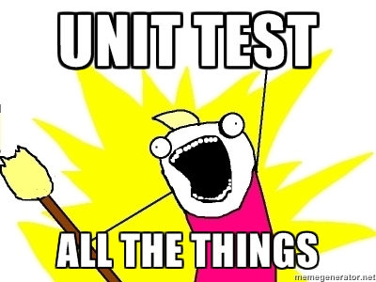
Testing the code

Slide 101
Testing the code
Why test?
  Assures correctness of the program under specific conditions
  Thinking of testing while coding makes the coder design a code that is better designed
  Helps you think about edge cases (e.g. What if user tries to delete a file that isn’t there? What if a function that takes mutable data is given an immutable type?)

Slide 102
Testing the code
even.py
  def is_even(num):
  """ (int) -> bool
  return True if num is even"""
  return number % 2 == 0

Slide 103
Testing the code
Docstrings omitted for space!
Test_even.py
  import unittest
  class EvenTestCase(unittest.TestCase):
  def test_is_two_even(self):
  self.assertTrue(is_even(2))
  if __name__ == '__main__': unittest.main()

Slide 104
Testing the code
In unit testing, test_* methods are recognized by the module.
Also, setUp and tearDown are special methods

Slide 105
Testing the code
Test_even.py
  import unittest
  class EvenTestCase(unittest.TestCase): """Tests for `even.py`."""
  def setUp(self):
  pass
  def tearDown(self):
  pass
  if __name__ == '__main__': unittest.main()

Slide 106
Classes and objects - complex e.g.
As a user of the IPhone class, we usually don't want to know what goes on under the surface. And Apple certainly doesn't want us messing around with what's inside (we might screw things up!). So this is how we might think about a class as a client:
class IPhone:
def __init__(self):
"""Initialize the iPhone"""
...
def call(self, phone_number):
"""Call the given phone number"""
...
def kill_switch(self, authorization_code):
"""Brick the iPhone"""
...
# Then we can make an IPhone object and use it!
precious = IPhone()
precious.call('123.456.7890')

Slide 107
Classes and objects - complex e.g.
As a developer, we want to hide the implementation as much as possible. This lets us change our implementation later without breaking everything!
class IPhone:
def __init__(self):
"""Initialize the iPhone"""
# Private attributes start with an underscore "_"
self._call_timer = 0
self._recent_calls = []
self._network = RogersNetwork(self)
def call(self, phone_number):
"""Call the given phone number"""
self._recent_calls.append(phone_number)
self._network.connect(phone_number)

Slide 108
Exercise 6: NumberList
Write a class that stores a list of integers/floats and provides the following methods:
sum() - return the sum of the numbers in the list
mean() - return the average of the numbers in the list as a float
min()/max()- return the minimum/maximum element
num_unique() - return the number of unique elements in the list
For example:
>>> nl = NumberList([1, 2, 5, 1, 4, 3, 3])
>>> nl.sum()
19
>>> nl.num_unique()
5
Hint: Use the in keyword:
>>> nums = [1, 3, 9, 16]
>>> 3 in nums
True
>>> 7 in nums
False

Slide 109
Exercise 6: Solution
class NumberList:
def __init__(self, L):
self._L = list(L) # make a copy
def sum(self):
result = 0
for value in self._L:
result += value
return result
def mean(self):
n = len(self._L)
return self.sum() / n

Slide 110
Exercise 6: Solution
...
def max(self):
result = None
for value in self._L:
if result is None or x > result:
result = x
return result

Slide 111
Exercise 6: Solution
...
def num_unique(self):
# One of many possible solutions
# Also: return len(set(self._L))
seen = []
for value in self._L:
if value not in seen:
seen.append(value)
return len(seen)

Slide 112

fin

